Slide 1
The Cool Factor: Security's Secret Weapon
Marisa Fagan
AppSecEU - July 1, 2016

Slide 2
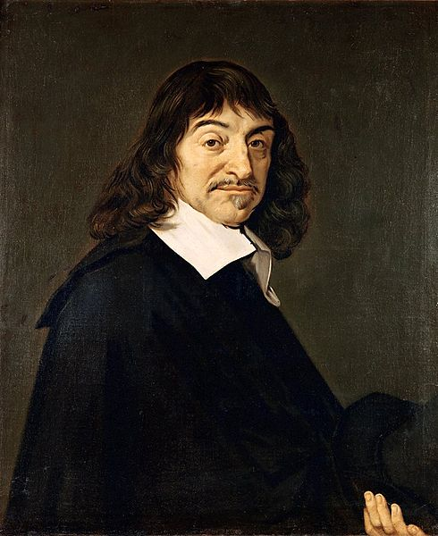
Who am I?
Security Culture Expert
Community Builder
Computer Information Systems Specialist
Art Enthusiast
In the scene since DEFCON 11
Rene Descartes portrait by Frans Hals, 1648
Notes:
Rene Descartes (painted by famous Dutch painter Frans Hals) bears a remarkable likeness to Marisa Fagan. They both have long hair and wear lots of black. Descartes said “I think therefore I am”. Marisa Fagan said “I am what I think is cool”.

Slide 3
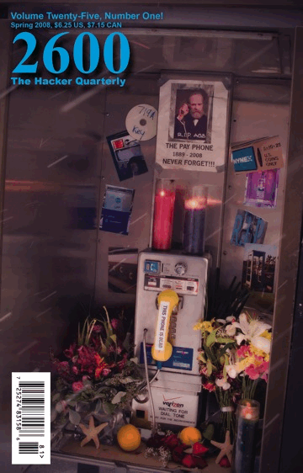
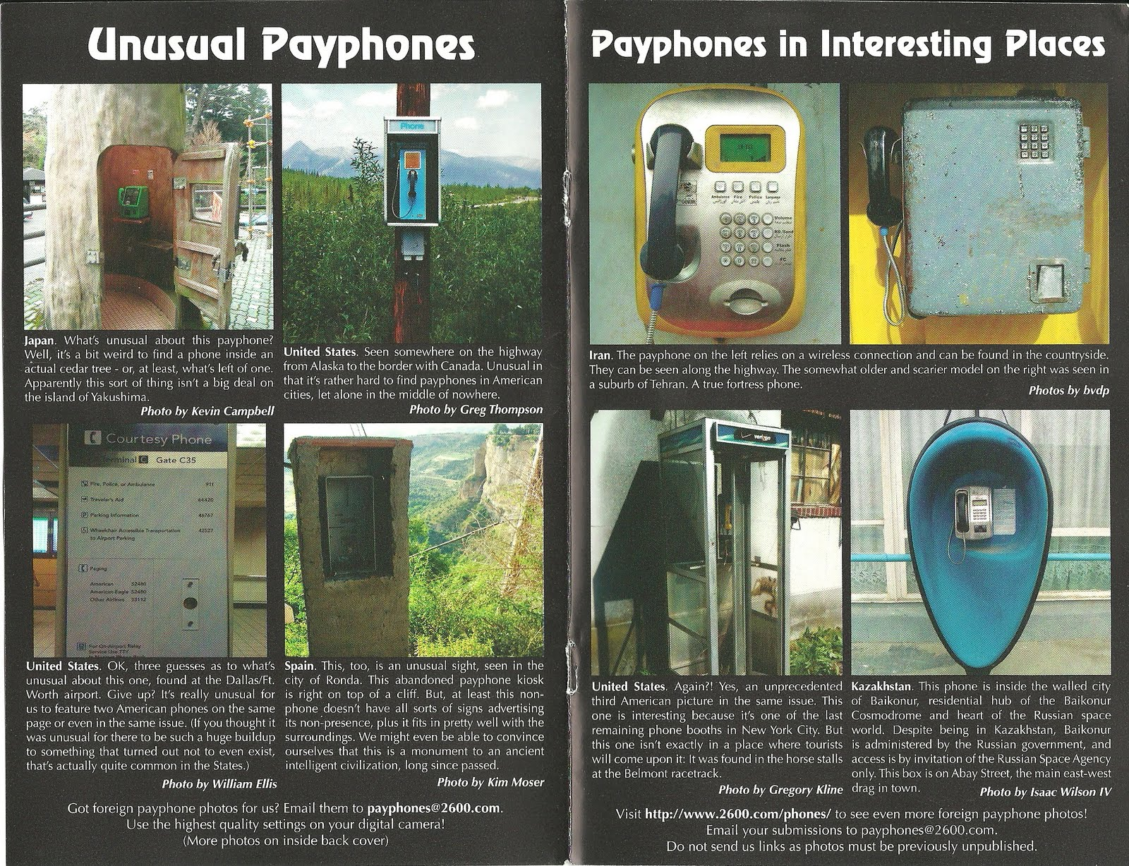
Humble Beginnings
Notes:
A story about the first time I read 2600 magazine and my consequent beginnings in the security industry.

Slide 4
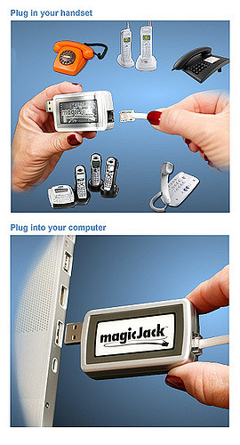
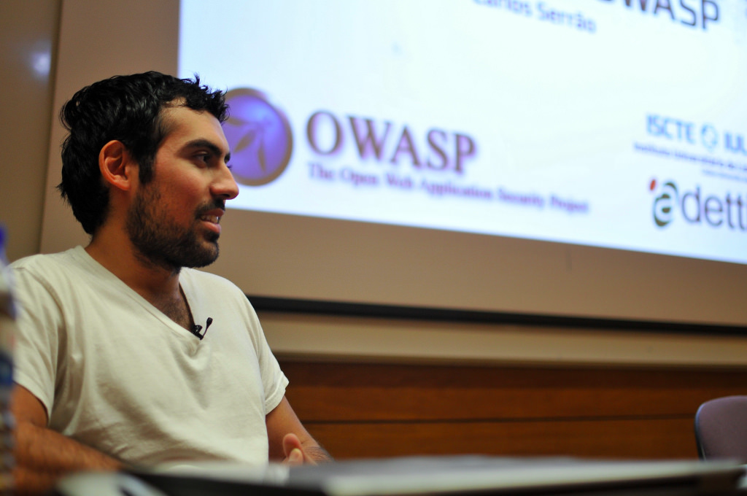
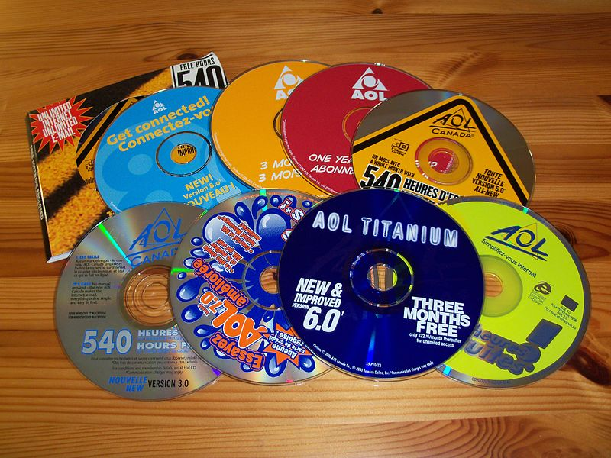
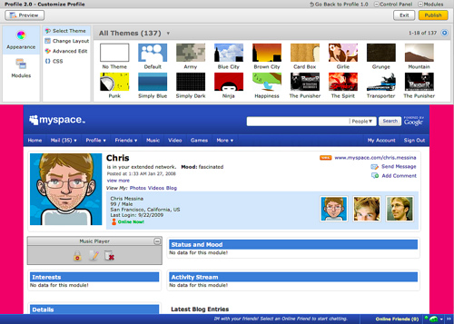
Early Days of Hacking in Pop Culture
flickr - iscteiul, flickr - factoryjoe, flickr - freephotos70
Notes:
In the early days of the internet, the average person was exposed to many hacks without realizing it, and it formed the basis for the general understanding of what hacking is and how the internet works that we base security awareness education on today.

Slide 5
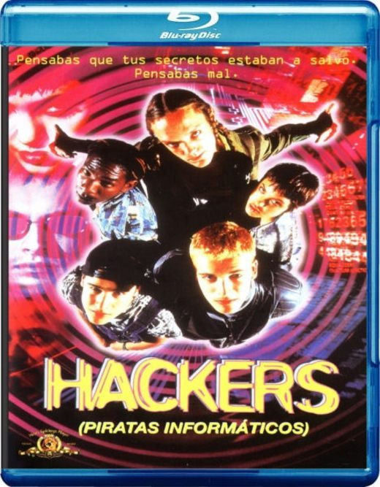
The Ultimate Hacker Culture Film
Hackers (1995)
Notes:
Hackers the movie was the ultimate example of security culture because it used the intersections of technology, fashion, and music.
Pensabas que tus secretos estaban a salvo. Pensabas mal. “ You thought your secrets were safe. You thought wrong.”

Slide 6
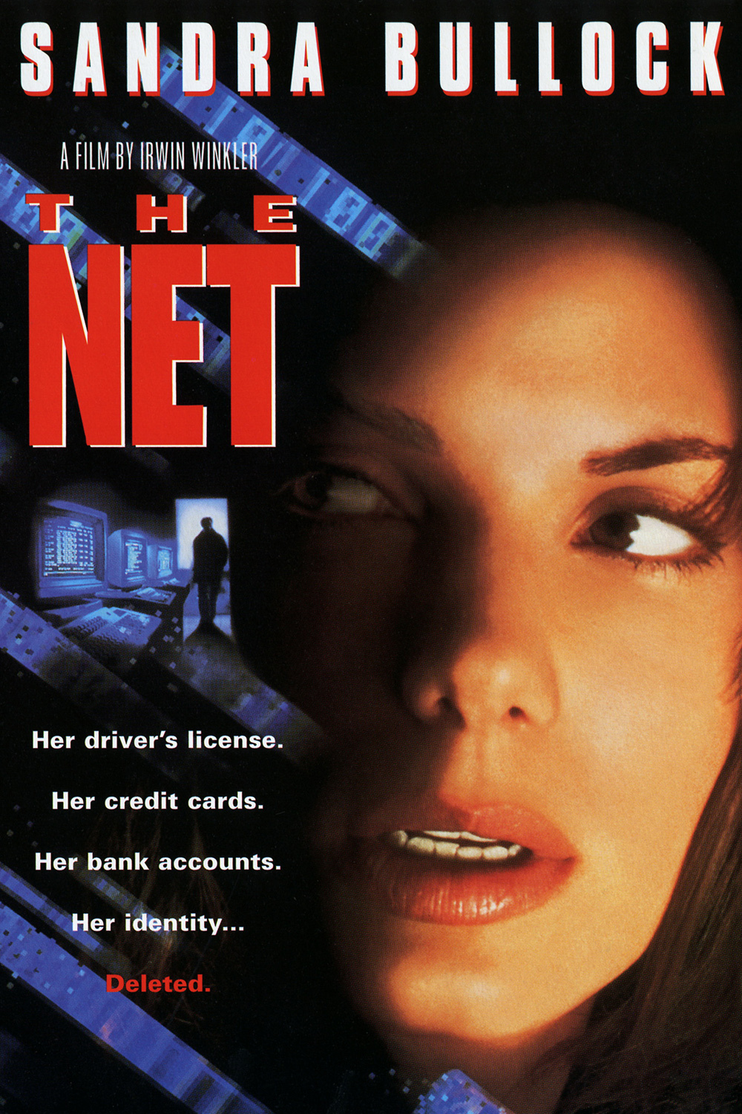
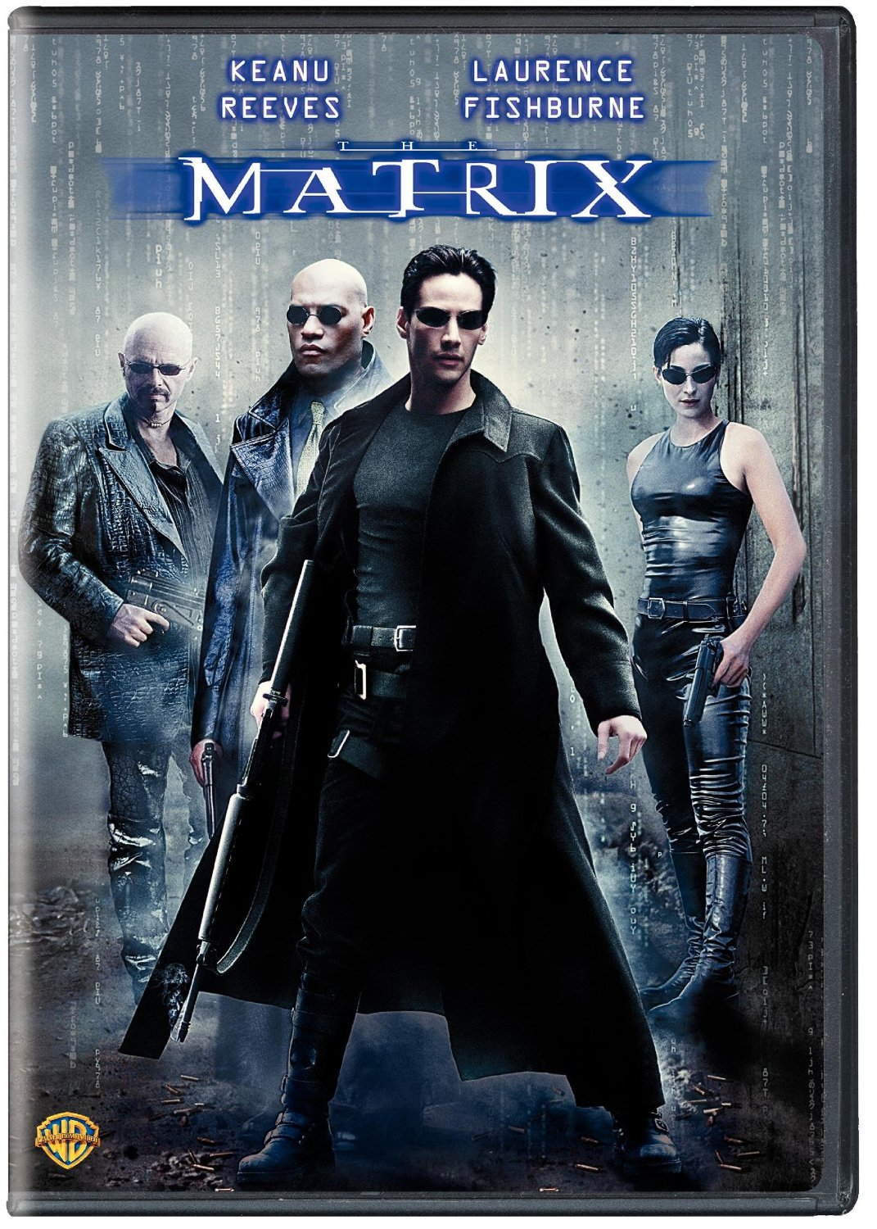
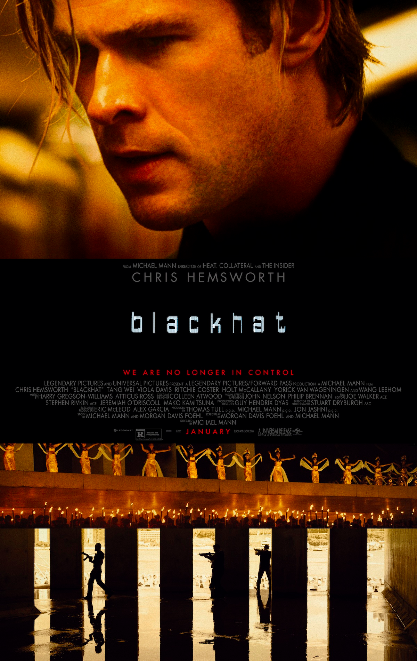
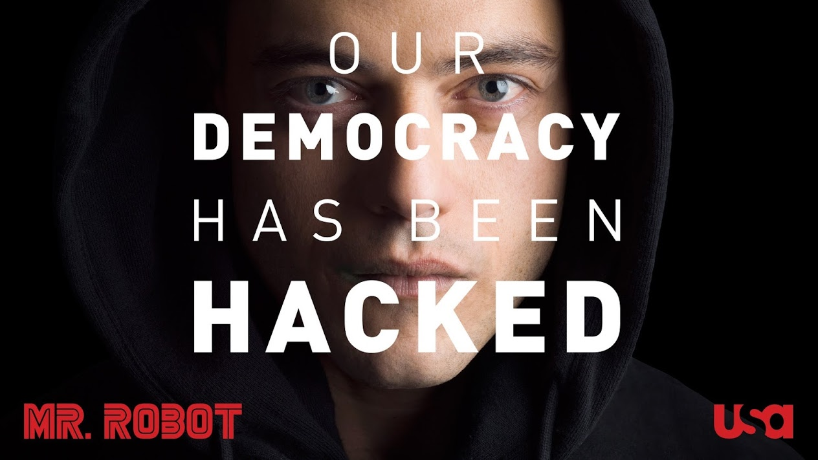
The Cool Factor: Security
in Pop Culture
Hacking in movies
To save the day
To end the world
Skills beyond the average person’s grasp
Computers are everywhere
Anti-corporate and youthful
Curiousity
Notes:
The average consumer sees hacking all the time in pop culture. It’s a skill beyond our grasp, and it makes everything everywhere within the hackers grasp. But you don’t have to be a hacker to understand and recognize what hacking looks like.

Slide 7
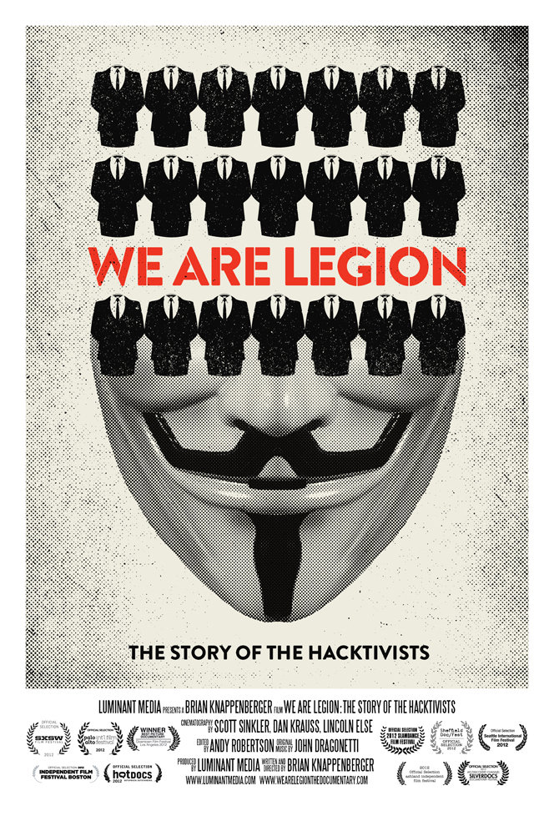
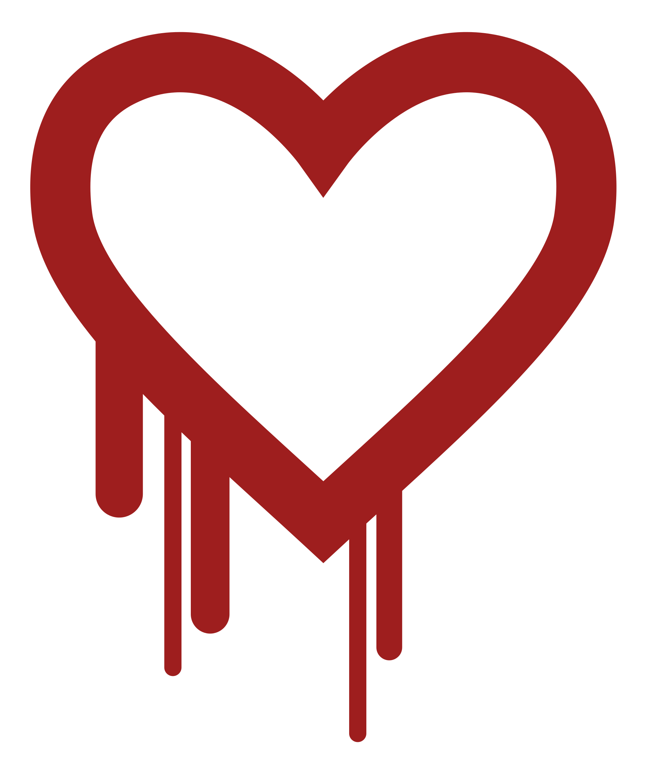
Security in the News
Consumers see breaches often
Point-of-Sale Systems
Identity Theft
Stuxnet
Melissa virus spread through email in 1999
Kevin Mitnick
Anonymous
Heartbleed logo
Notes:
Breaches and attackers from the past 15+ years that have built the public understanding of hacking in the USA.

Slide 8
But what is culture?
Culture is
Recognizable
Pervasive
Behavior and Values
Endorsed by the top leadership
Driven by the largest audience

Slide 9
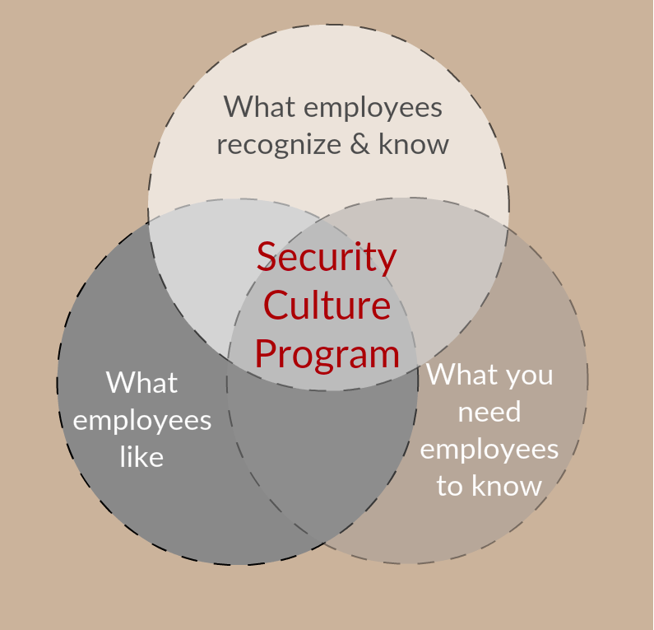
Security + Culture
(You could do it with any two of the three, but three is best)
Notes:
What is security culture? The sum of the recognizable and pervasive behaviors and beliefs around the employee’s relationship to the security posture of the company. Different roles will have different relationships to security and different sub-cultures under the umbrella culture set by the leadership (CEO)
Thanks to “The Cool Factor” the average employee actually does have a working knowledge of what security looks like. Using this as a base will trigger recognition which paves the way for the new content.

Slide 10
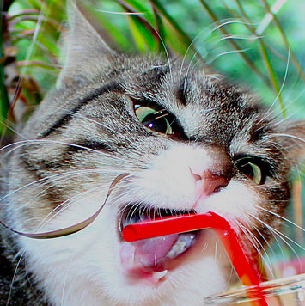
Security Culture Program
Building on employees baseline knowledge and experiences about security
Intersecting pop culture, safety, and business experience
Not just “Security Awareness”!!
SCP defines a culture for all employees, as well as sub-cultures for engineers, sales, ops, etc.
(Cats-attacking-straws Sub-culture??)

Slide 11
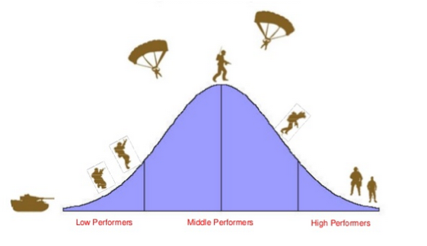
Security Culture Program
Core components:
Training
Ubiquitous Marketing
“An ambiance of security”
Incentives
Executive Leadership
Role-based Niche Groups
Measurements
Engagement Bell Curve

Slide 12
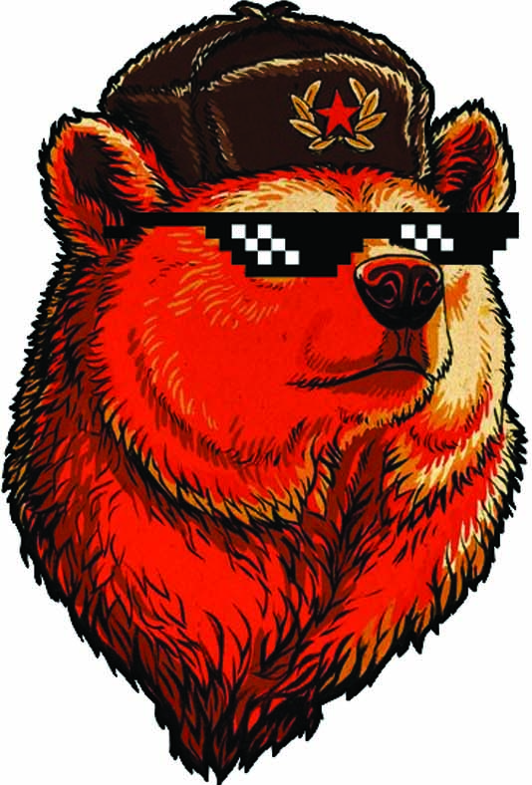
Red Teams & Identifying Behaviors
SCP is the Red Team’s friend!
SCP is the remediation to your simulations
Penetration Tests identify key employee behaviors needing change
Future penetration tests are metrics for SCP success

Slide 13

Root Cause Analysis
Security starts and ends with behaviors
Ask “Why?” 5 times to find the root cause motivation
Before you begin, ask “Can you solve this with technology?”

Slide 14
Questions about Security Culture Programs?
Resources:
Lance Hayden - “People-Centric Security: Transforming Your Enterprise Security Culture”
Kai Roer - https://securitycultureframework.net/
Notes:
Pause for questions about the Security Culture Maturity Model before moving on to the T-shirts topic.

Slide 15
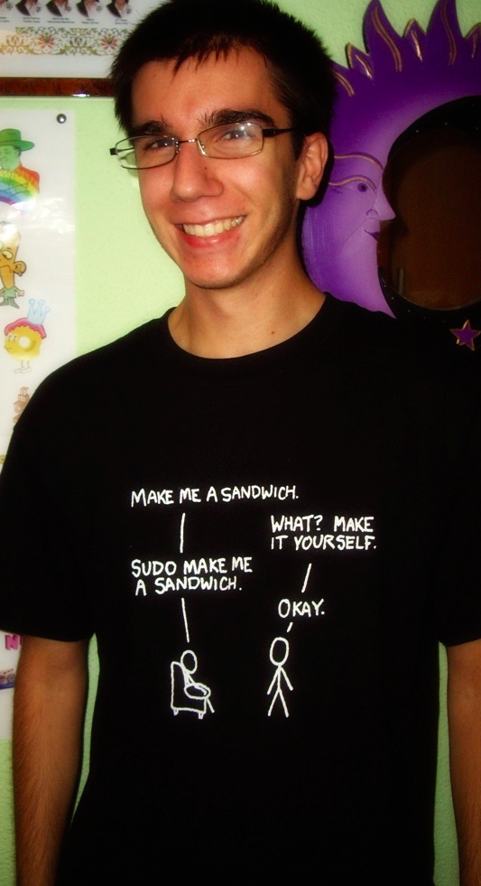
Bonus slides!!!
How to create a t-shirt people will wear:
What does your audience like?
What will they recognize?
What do you need them to know?
If you successfully answer all three, you create a sense of community and awareness
flickr - draxus
Notes:
Answering these 3 questions will guide you in your brainstorming for a shirt design. Nothing is out of bounds. Thinking outside of the cliche box is always rewarded. Don’t feel required to go “security themed.” The most popular designs are everything but that. Cartoons and vivid colors are popular because they remind us of things we already know we like.Pop culture is about familiarity... more important than being clever or topical... pick something simple and cute. Large black and white designs are eye-catching, but they must work one step harder to tell a story that is recognizable.

Slide 16
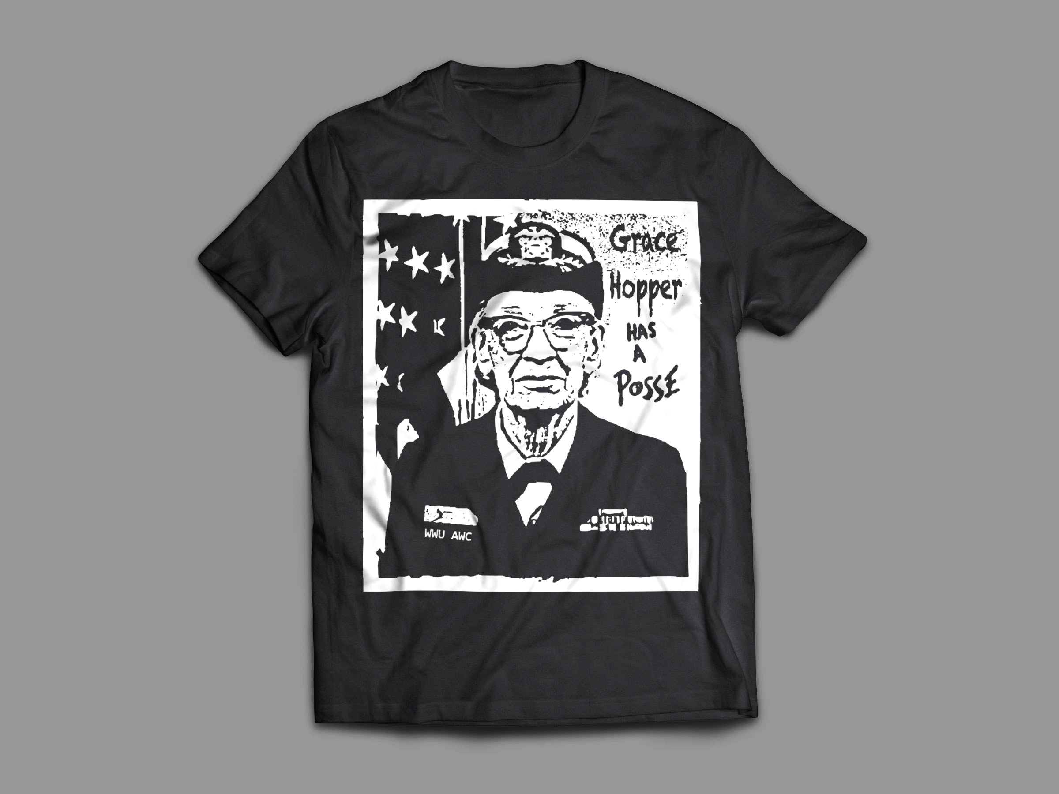
Grace Hopper Has A Posse
Since 2014, about 3,000 t-shirts printed by Bugcrowd.
Grace Hopper is a computer science legend.
She famously used the phrase “It's easier to ask forgiveness than it is to get permission.”
The original hacker mindset.
Those that recognize her are in the know and part of the club

Slide 17


Other T-shirts
Notes:
More examples of designs related to security messages that were popular because of their familiarity and interesting story.
These are my designs used by Salesforce Trust Team.

Slide 18
More T-shirts

Slide 19
Takeaways
Give your audience credit. They’ve been seeing hackers for years. Find out their “why’s”.
A Security Culture Program is a method of creating “an ambiance of security”.
Create designs that you would want to wear.
The Cool Factor is telling a story that your audience is “in on” and recognizes they belong with.

Slide 20
Thank you!
Contact:
Marisa.Fagan@salesforce.com
Are you a security culture program practitioner? Let’s talk! Please send me an email and we can share stories.

